Slide 1
PX5710/PX5718
Statistics and Time Series Analysis
Time Series Analysis-Time domain analysis
2025-26 Term 2
Department of Physics
Dr. Andrew Angel andrew.angel@abdn.ac.uk Meston 339
Dr Sandip George sandip.george@abdn.ac.uk Fraser Noble 141
Dr. Andrew Angel andrew.angel@abdn.ac.uk Meston 339
Dr Sandip George sandip.george@abdn.ac.uk Fraser Noble 141

Slide 2
Time Series
A time series is a sequence of data points listed in time order, usually equally-spaced in time
Time is an independent variable and provides a natural temporal ordering
Time series analysis: Used to extract meaningful statistics and other characteristics from the data
Time series forecasting:
Building a model to predict future values based on previously-observed values
Time series are typically characterised by
trends, periodicities, seasonality, variability, noise, and chaos
But first, some preliminaries.

Slide 3
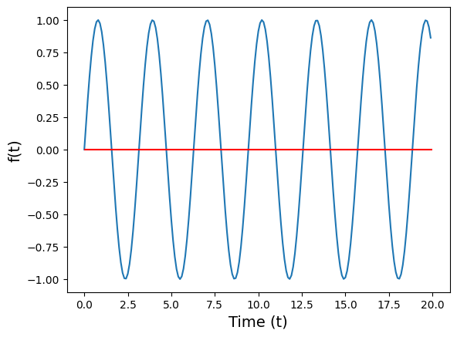


Special time series: The sine wave
A simple harmonic oscillation is represented by a sine function
Properties
For every value of frequency, F, f(t) is periodic
Increasing F leads to an increase in the rate of oscillations of the signal (more periods per time interval)
For period, T_{p}(=1/F),
Each sine wave with a distinct frequency is distinct
Euler's formula

Slide 4



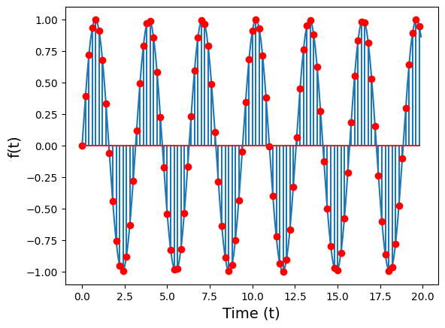
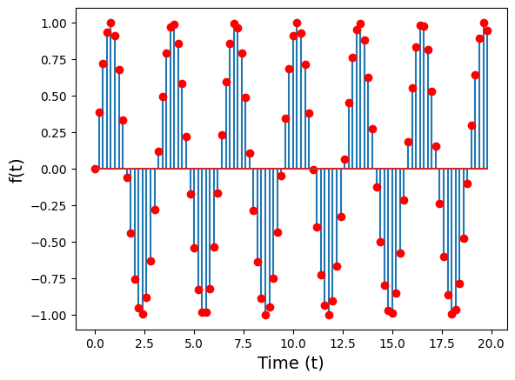
Continuous vs discrete time series
A continuous time series is one that varies over continuous time, i.e. the domain of the time series is continuous.
A discrete time series is only defined at discrete points in time
Sampling a continuous time variable at discrete intervals
An inherently discrete process (number of individuals in generation i)

Slide 5


Sampling a continuous signal
The most common way to sample a continuous signal is uniformly sampling it
If f(t) is the continuous signal,
the corresponding discrete signal, sampled at Δt is obtained as
How should you sample a sin wave? Depends on the frequency, f
Sampling period: Δt

Slide 6
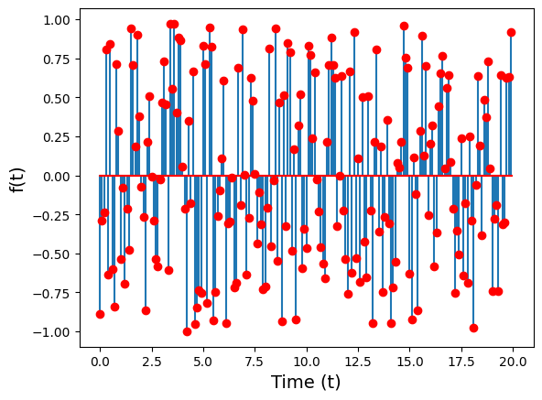
Special time series: white noise
Time series where each point in time is unrelated to the next
Properties
f(t) has zero correlation with f(t+n), n=1,2,3,...
Should have finite variance
When the distribution of f(t) is uniform: uniform white noise
When the distribution is Gaussian (normal): Gaussian white noise
How do we quantify this correlation?

Slide 7
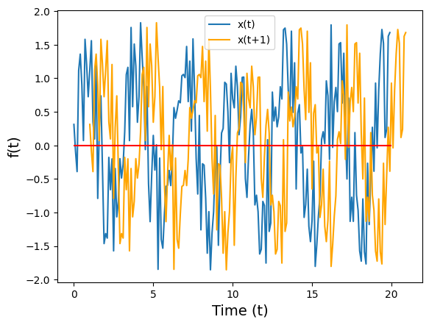
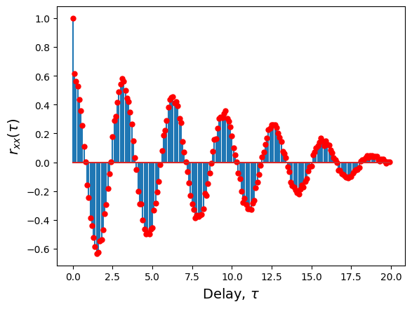
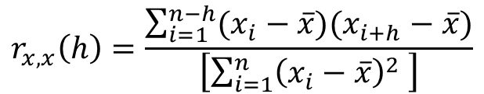
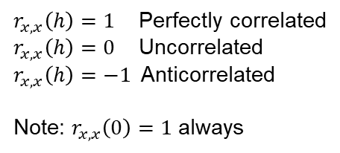

The autocorrelation function
If we have a discrete time series, x(n), the autocorrelation of x(n) for a time delay of h points is defined as
$$r_{x,x}\left(h\right)=\frac{\sum_{i=1}^{n−h}{(x_{i}−\overline{x})(x_{i+h}−\overline{x})}}{\left[\sum_{i=1}^{n}{{\left(x_{i}−\overline{x}\right)}^{2} }\right]}$$
Pearson correlation coefficient, for a time delayed version of the time series
$$r_{x,x}\left(h\right)∈[−1, 1]$$
What is the correlation when h=0?
$r_{x,x}\left(h\right)=1$ Perfectly correlated
$r_{x,x}\left(h\right)=0$ Uncorrelated
$r_{x,x}\left(h\right)=−1$Anticorrelated
Note: $r_{x,x}\left(0\right)=1$ always
τ=h*Δt
Example: autocorrelation_lecture.nb

Slide 8
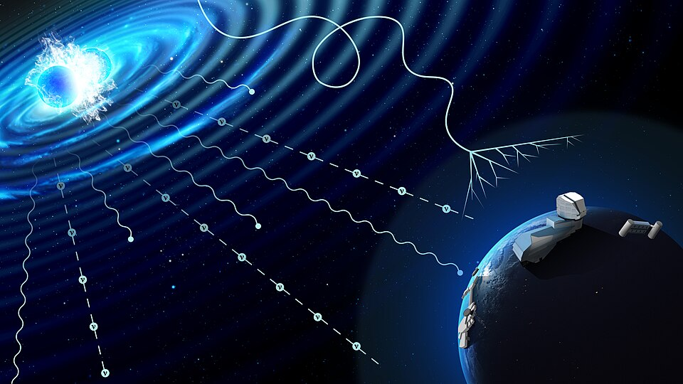
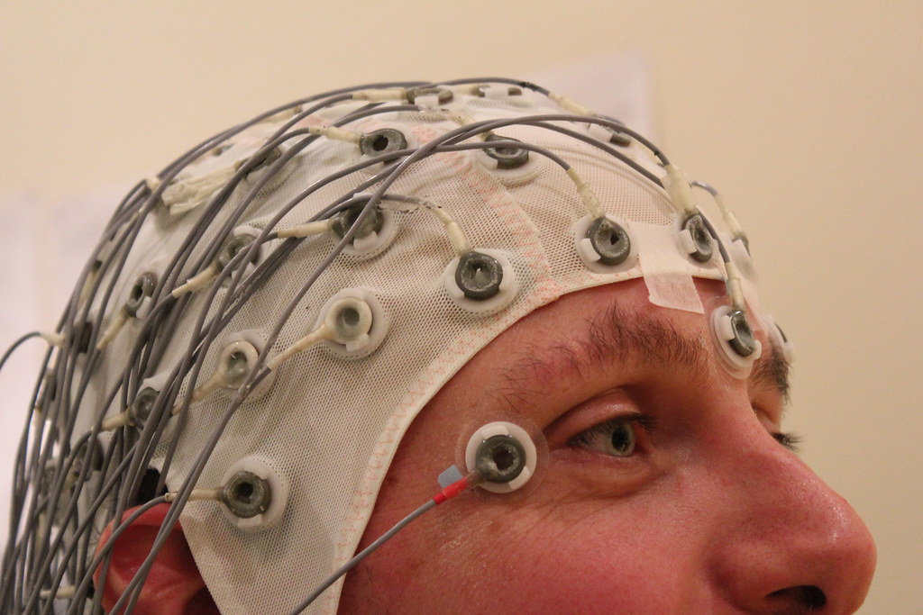
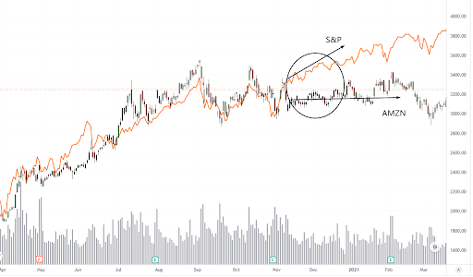
Multiple related time series
Wikimedia commons, Rubin Observatory/NOIRLab/NSF/AURA/P. Marenfeld
"Volunteer Duty" Psychology Testing Photo by Chris Hope, flickr.com
https://tradersunion.com/interesting-articles/when-to-sell-stocks-top-5-triggers/

Slide 9
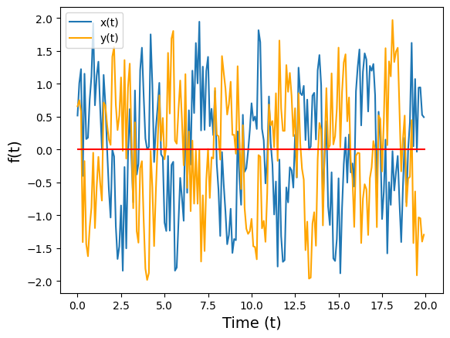
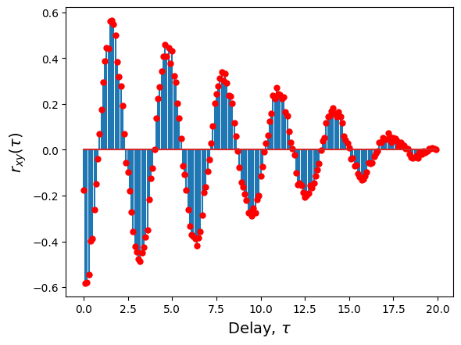

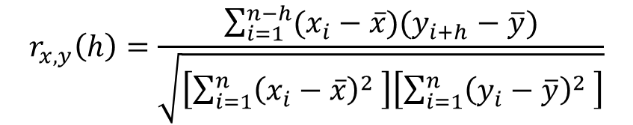
Cross-correlation
We can generalize the autocorrelation function to the correlation between two time series.
$$r_{x,y}\left(h\right)=\frac{\sum_{i=1}^{n−h}{(x_{i}−\overline{x})(y_{i+h}−\overline{y})}}{\sqrt{\left[\sum_{i=1}^{n}{{\left(x_{i}−\overline{x}\right)}^{2} }\right]\left[\sum_{i=1}^{n}{{\left(y_{i}−\overline{y}\right)}^{2} }\right]}}$$
$$r_{x,y}\left(h\right)∈[−1, 1]$$
τ=h*Δt
Pearson correlation coefficient, for a time delayed version of two time series

Slide 10
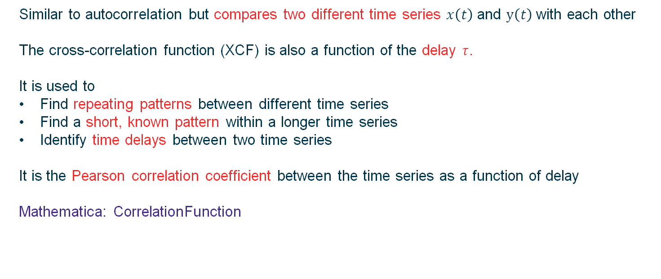

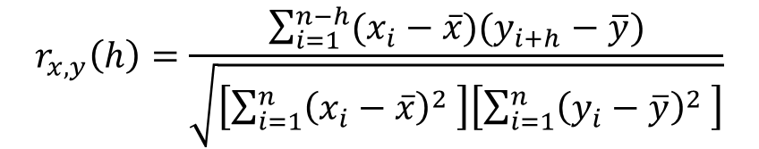
Cross-correlation
Similar to autocorrelation but compares two different time series $x\left(t\right)$ and $y\left(t\right)$with each other
The cross-correlation function (XCF) is also a function of the delay $τ$.
It is used to
Find repeating patterns between different time series
Find a short, known pattern within a longer time series
Identify time delays between two time series
It is the Pearson correlation coefficient between the time series as a function of delay
Mathematica: CorrelationFunction
$$r_{x,y}\left(h\right)=\frac{\sum_{i=1}^{n−h}{(x_{i}−\overline{x})(y_{i+h}−\overline{y})}}{\sqrt{\left[\sum_{i=1}^{n}{{\left(x_{i}−\overline{x}\right)}^{2} }\right]\left[\sum_{i=1}^{n}{{\left(y_{i}−\overline{y}\right)}^{2} }\right]}}$$
$$r_{x,y}\left(h\right)∈[−1, 1]$$

Slide 11
Cross-correlation
Raw time series
Cross-correlation function
Example: crosscorrelation_lecture.nb

Slide 12
Time-domain analysis
Visualisation and processing in Mathematica
Plotting using line charts: ListLinePlot
Binning the data: BinCounts
(grouping data by some property)
Smoothing the data: MovingAverage MovingMedian MeanFilter
(producing a visually smoother time MedianFilter MinFilter MaxFilter
series to identify underlying trends) GaussianFilter
Filtering the data: GradientFilter LaplacianFilter
(modifying certain frequencies) LowpassFilter HighpassFilter BandpassFilter
Interpolating or fitting the data: Interpolation Fit FindFit
(predicting values at arbitrary times) LinearModelFit NonlinearModelFit
Examples: binning_spiketimes.nb (Binning)
interpolation_fit.nb (Interpolation and fitting)

Slide 13
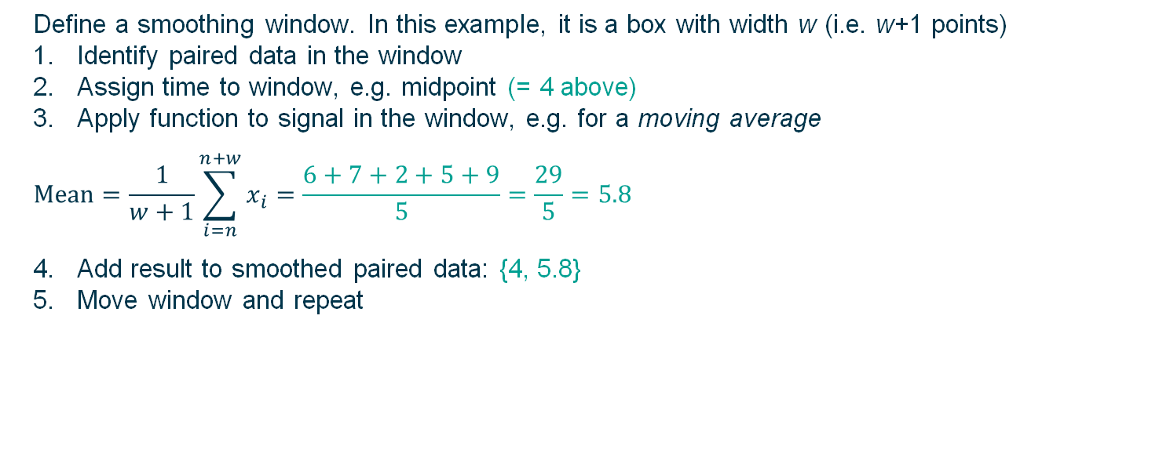
Smoothing data
Window with width w = 4 at n = 3
Index n: 1, 2, 3, 4, 5, 6, 7, 8, 9, 10, 11, 12, 13, 14, 15, …
Time t: 0, 1, 2, 3, 4, 5, 6, 7, 8, 9, 10, 11, 12, 13, 14, …
Signal x: 3, 5, 6, 7, 2, 5, 9, 32, 42, 12, 24, 33, 46, 86, 11, …
Define a smoothing window. In this example, it is a box with width w (i.e. w+1 points)
Identify paired data in the window
Assign time to window, e.g. midpoint (= 4 above)
Apply function to signal in the window, e.g. for a moving average
$$Mean=\frac{1}{w+1}\sum_{i=n}^{n+w}{x_{i}}=\frac{6+7+2+5+9}{5}=\frac{29}{5}=5.8$$
Add result to smoothed paired data: {4, 5.8}
Move window and repeat
Mathematica: MovingAverage
MeanFilter

Slide 14
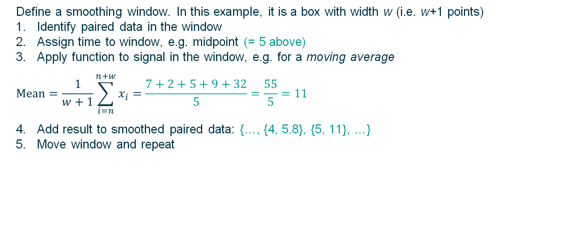
Smoothing data
Window with width w = 4 at n = 4
Index n: 1, 2, 3, 4, 5, 6, 7, 8, 9, 10, 11, 12, 13, 14, 15, …
Time t: 0, 1, 2, 3, 4, 5, 6, 7, 8, 9, 10, 11, 12, 13, 14, …
Signal x: 3, 5, 6, 7, 2, 5, 9, 32, 42, 12, 24, 33, 46, 86, 11, …
Define a smoothing window. In this example, it is a box with width w (i.e. w+1 points)
Identify paired data in the window
Assign time to window, e.g. midpoint (= 5 above)
Apply function to signal in the window, e.g. for a moving average
$$Mean=\frac{1}{w+1}\sum_{i=n}^{n+w}{x_{i}}=\frac{7+2+5+9+32}{5}=\frac{55}{5}=11$$
Add result to smoothed paired data: {…, {4, 5.8}, {5, 11}, …}
Move window and repeat
Mathematica: MovingAverage
MeanFilter

Slide 15
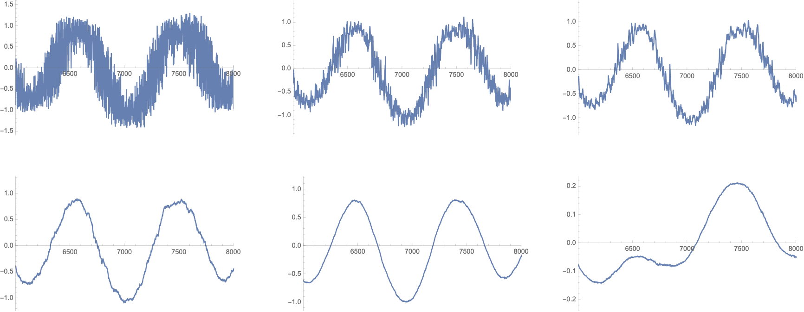

Smoothing using a moving average of different widths
$$Mean=\frac{1}{w+1}\sum_{i=n}^{n+w}{x_{i}}$$
Signal x: 3, 5, 6, 7, 2, 5, 9, 32, 42, 12, 24, 33, 46, 86, 11, …
Window
Raw data
w = 5
w = 10
w = 50
w = 200
w = 1000
Mathematica: MovingAverage, MeanFilter

Slide 16
Choice of smoothing functions
MeanFilter Replace data in window with mean value (moving average)
Choose width depending on which frequencies you want to remove
MedianFilter Replace data in window with median value
Good where there are large outliers that would skew a mean filter
MinFilter Replace data in window with minimum value
MaxFilter Replace data in window with maximum value

Slide 17
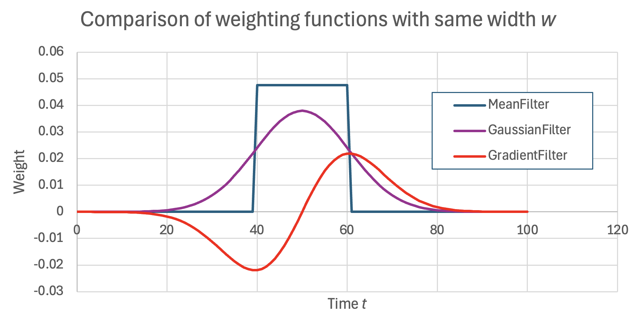
Choice of smoothing functions
GaussianFilter Replace data in window with a weighted average
Weighting function is a Gaussian centered on the middle of the window
(Compare with a step function for the mean filter)
Width is the standard deviation of the Gaussian
Compare with MeanFilter:
More weight at middle of window
Individual points do not suddenly enter and leave the window
Individual points exert an influence over a larger range of smoothed points
Smoothing is “gentler”
Preserves sharp changes better
Includes whole time series in each sum
GradientFilter Replace data with an approximation of the gradient of the time series at each point
Mathematica smoothes using the gradient of the Gaussian function as the weights
Use when you want to find where the time series changes rapidly
LaplacianFilter: Similar effect, replacing data with
its approximate second derivative
Example: smoothing.nb

Slide 18
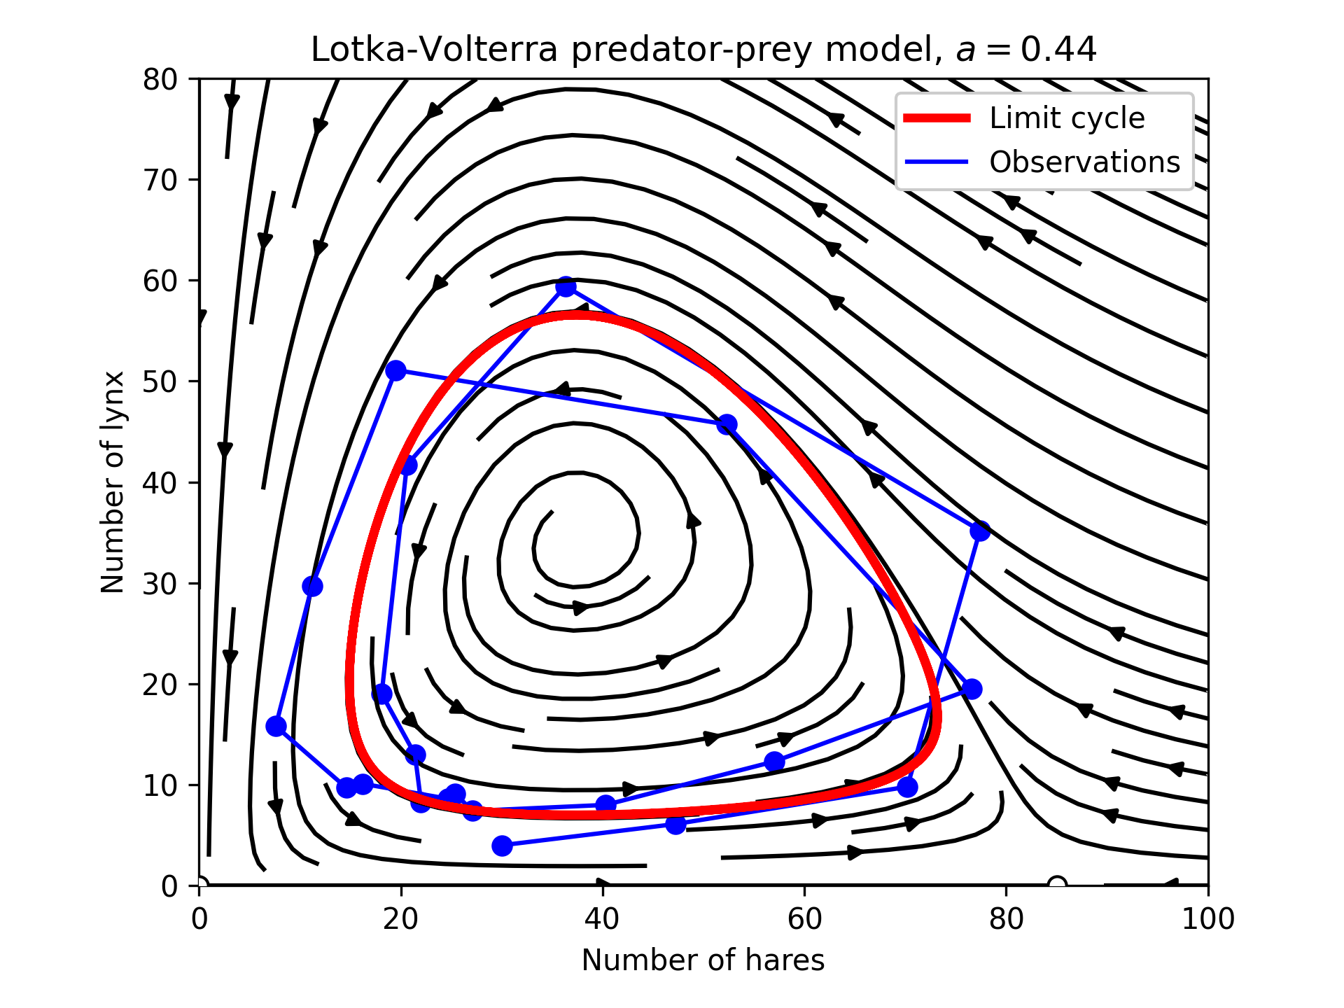
Cross-correlation
Aside, for general interest:
Lotka-Volterra predator-prey model compared with hare-lynx data used in Example 5.
This is a nonlinear model of the interaction between two populations – one predator population, one prey population.
Possible outcomes are
Both populations die out (will occur if all prey die)
Prey population stabilizes (will occur if all predators die)
Cycle between predator and prey (when natural predator death rate is low)
Equilibrium between predator and prey (when natural predator death rate is high)

